Slide 1
Sheep Workshop
Committee: SUPERINTENDENT – Debbie Talbert (443-398-6301) Assistants – Alexis Masimore (443-375-1115), Jeff Hevner (410-984-7712) Chad Becker (443-536-2544), Brad Rill, Jason Talbert, Katie Yingling (443-547- 3996), Megan McGregor (443-487-3392), Tyler Rill, Brooke Gotwalt & Tyler Talbert

Slide 2
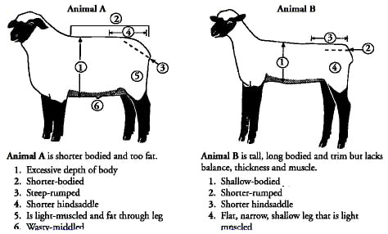
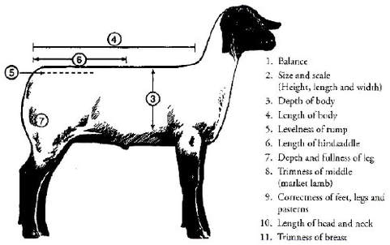
What to look for when picking a Market Lamb
Things to Avoid
Market Lamb Selection - YouTube
Things to look for
Pictures from Ideal Market Lamb: How to Buy a Lamb That Will Win! (raisingsheep.net)

Slide 3
Caring for your Market Lamb
-Feed Daily
-Clean Water
-Clean Pen
-Walk/exercise your lamb to help build muscle
-Practice bracing and setting up your ring for the show
-How to brace video Teaching Show Sheep to Brace - YouTube

Slide 4
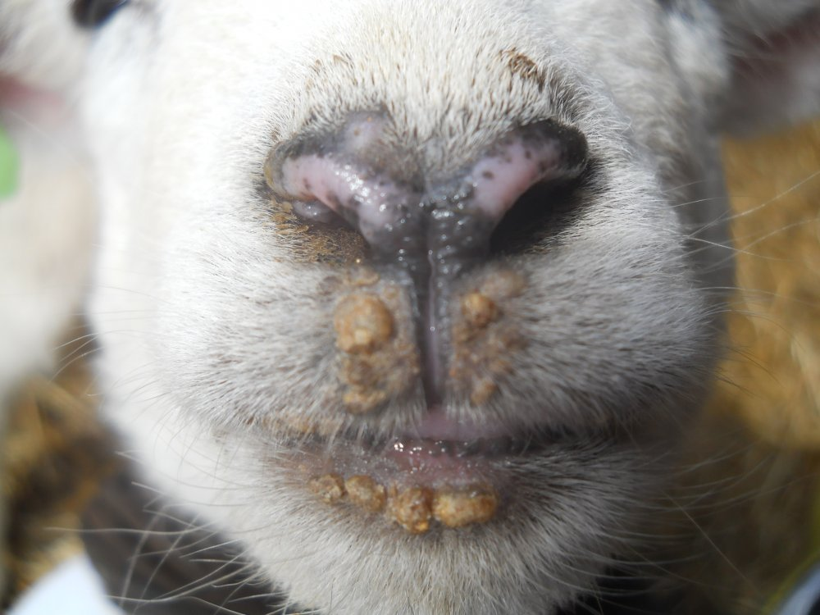
Diseases
-Sore Mouth
-symptoms-sores are usually on lips and nostrils
-prevention- quarantine new animals
-Highly contagious- if one animal gets it more than likely all of them will get it.
-Humans can get this as well. Be sure to wear gloves when handling a sheep with sore mouth and wash hands when done.
-Worms
-symptoms-weight loss, off feed, diarrea
-diagnosis-fecal sample from vet,Check mucus membrane (lower eyelid) a healthy non wormy sheep or goat will have a red eye lid the lighter in color it gets the more worms.
Picture from https://www.backyardherds.com/threads/sore-mouth.31371/

Slide 5
Diseases Continued
-Foot Rot
-symptoms- lameness, foot has foul order, area between hooves is red and moist
-treatment- Footbaths (1-2 time a week for several weeks) (Can also be used as a preventative measure after trimming hooves.) and antibiotics
-Coccidea
-symptoms-Diarrhea, dehydration, fever, weight loss
-treatment-Get fecal examine done by vet and get antibiotics-corid
-Club Lamb Fungus
-symptoms-Thick, scaly round pustules usually on head and neck area
-treatment- antifungal medication

Slide 6
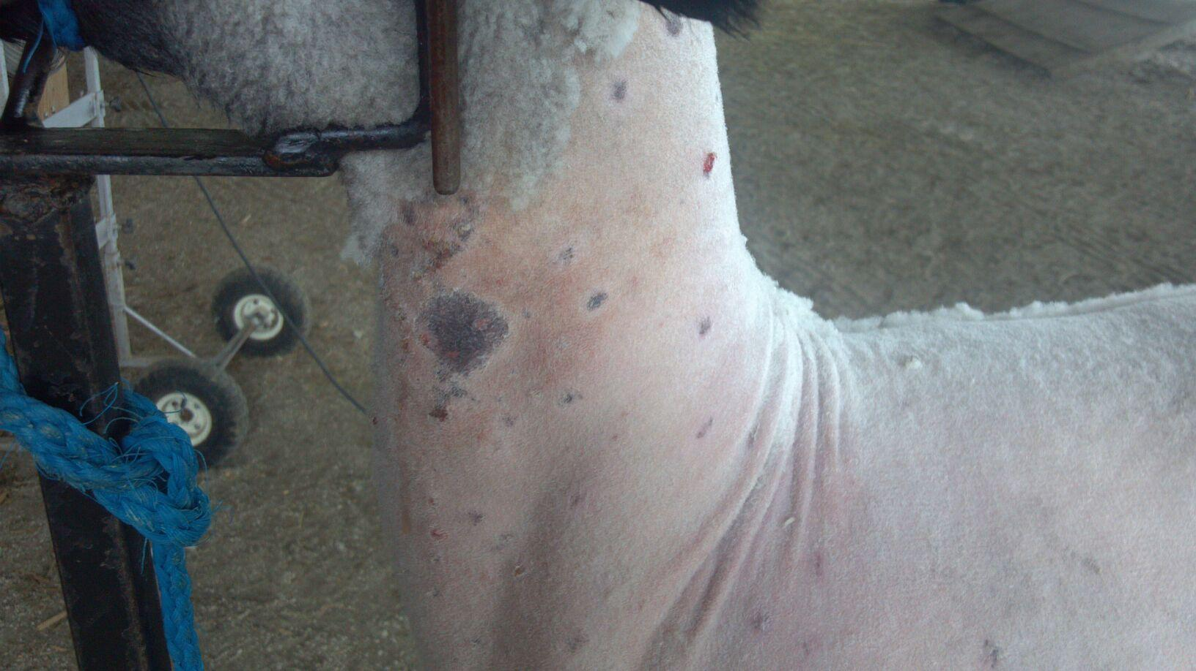
Diseases Continued
-Ringworm
-Symptoms- Round areas of hair loss, light flaky scabs, thick, crusty lesions, pustules, thickened, red, and "weepy" skin
-Treatment- Remove the wool for about 2 inches surrounding the ringworm. Remove the scab down to the skin by using a brush and soapy water. Ringworm can be then treated with fungus-killing medicines. Both topical and oral treatment can be administered which may help slow fungal growth (from 8-16 weeks down to 3 weeks).
-To ensure the infection is contained you should thoroughly disinfect equipment and isolate the infected sheep until the wool has grown back.
https://askavetsheep.wordpress.com/2013/07/23/
club-lamb-fungus-by-dr-j-l-goelz/

Slide 7
Getting ready for the Fair
-Show clothes
-White button up shirt with a collar, khaki pants, belt, bolo tie and boots
-Tack Box
-Halter, number holder, materials for washing your lamb (soap, brush, etc.). lamb tube or blanket to keep them clean
-Shear your sheep Show Sheep Shearing - YouTube

Slide 8
Sheep Rules
-A few important rules.
-Sheep should not leave the sheep area of the Shipley Arena.
-Only 1st year sheep exhibitors or exhibitors with special needs will be permitted assistance in the ring if needed excluding pairs and flock classes. The assistant must be a 4-Her of the same age or young
-Market lambs must be shown slick sheared when arriving at the fair. You may only touch up at the Fair. No stands are to be inside the barn.

Slide 9
Sheep Rules Continued
-Lambs must be born after January 1, 2021.
-No halters allowed in Market-Lamb classes or showmanship classes, unless allowed by Superintendent.
-Sheep must weigh 115-160 pounds to sell with a rate of gain of .35.
-Please view the full list of rules online. http://www.carrollcountyfair.com/fair-catalog.asp

Slide 10
Check For Understanding
1. Sheep only need fed 2 times a week.
False-Sheep need to have food and clean water every day.
2. Sheep need to be exercised and worked with to get them show ready.
True
3. Sale weight is 115-150 pounds.
True

